Slide 1
APP store monetization experiment design
Huili Si

Slide 2
Goal
VP of Product has set up the goal to increase entire store’s revenue by 5% in 2018

Slide 3
Steps
Understand business objectives
Exploratory data analysis
Make hypothesis
Design experiments
Make recommendations

Slide 4
Understand business objectives
increase entire store’s revenue by 5% in 2018
Total Revenue = Price * Quantity
So, there are two ways we can do to increase the revenue.
Avg spend of each client /
The sum of Avg spend of each purchase
The number of total clients /
purchase frequencies of each client

Slide 5
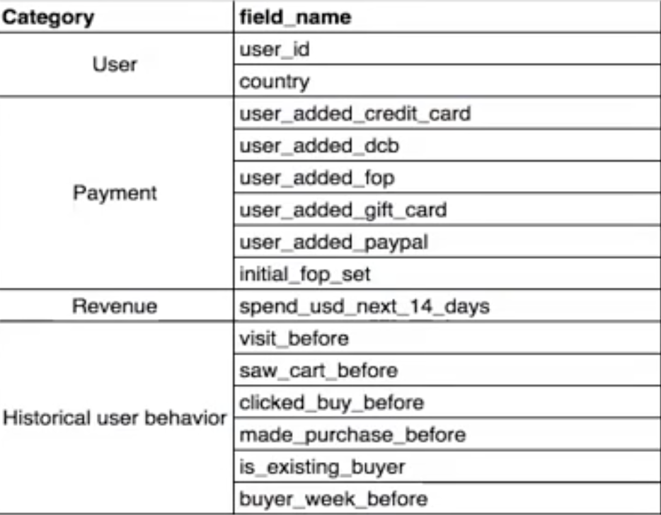
Exploratory data analysis
Data structure: 566699 rows, 15 dimensions
Dealing with missing values
Correlations among the 15 features
Notes:
分slides

Slide 6
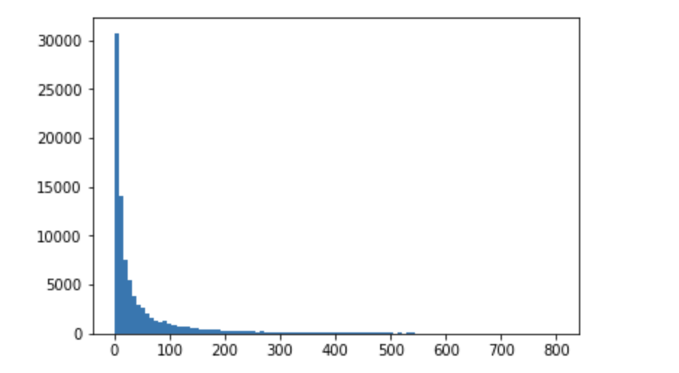
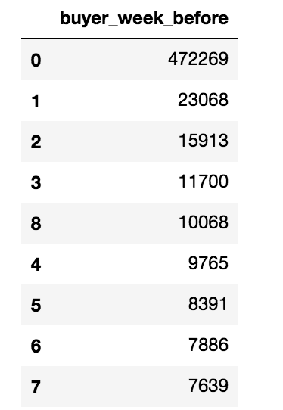
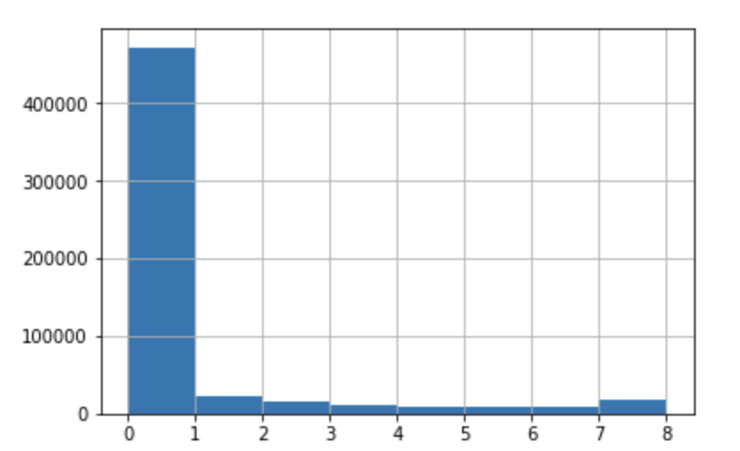
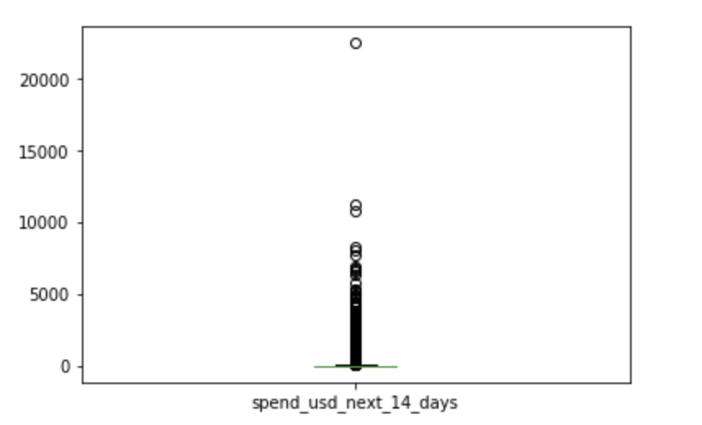
Exploratory data analysis(EDA)
Key features: spend_usd_next_14_days Buyer_week_before
Right Skewness
Mode < median<mean
Count
Spend
Outliners
Notes:
Spend_usd_next_14_days includes outliners which are difficult to identify. Eg, for the rich people, spending $10,000 on games in App stores is not a ridiculous thing.
But frequency is much easier to judge. If What kind of fops can stimulate more times purchases?

Slide 7
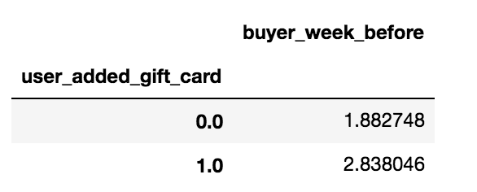
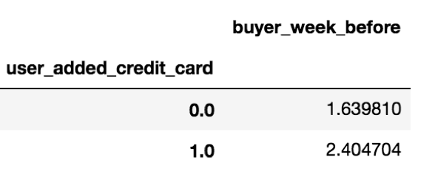
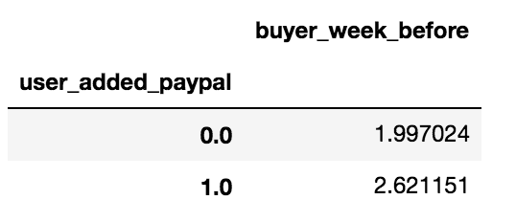
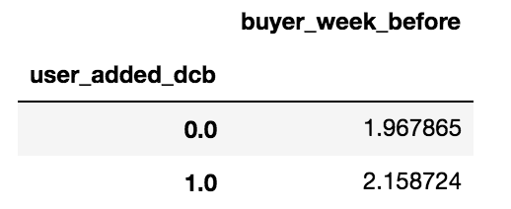
Exploratory data analysis(EDA)
Gap --- Opportunity:
Increase the frequencies of orders for each client

Slide 8
Make hypothesis
Make the hypothesis that the gift card payment positively influences the purchase frequency of each client as well as total of customers’ spending(revenue)

Slide 9
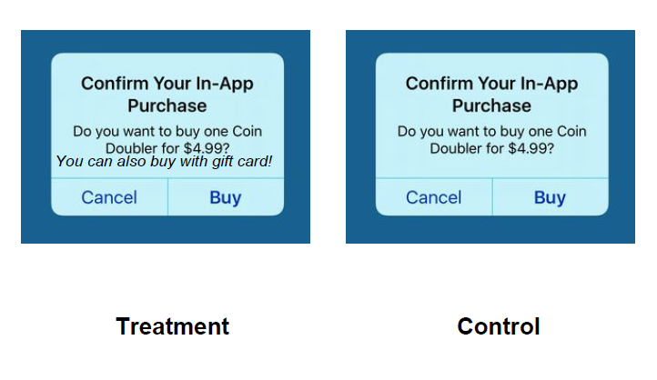
Design run experiments
Target population:
We did A/B test on group of users who have visited the store in the last 60 days.
Treatment:
For users who are in treatment group, we show them an additional message “also buy with gift card”.
Metric:
Average spending of each customer
Approach:
Tow samples t-test of average spend of treatment group comparing
Duration:
2 weeks

Slide 10
Result
T-Test Result:
statistic=-2.88, p-value=0.00396 <0.05
We can reasonably sure that average spend of treatment group is significantly more than 5% higher than that of control group under 95% confidence

Slide 11
Make recommendations
Stat sig
Turn it on
Focus on revenue growth and the new feature will likely increase revenue by 5%
Schedule of ramp up
Continue to track in case of seasonality and
Future work:
Change the metric: Average purchase frequency of each customer

